Slide 1
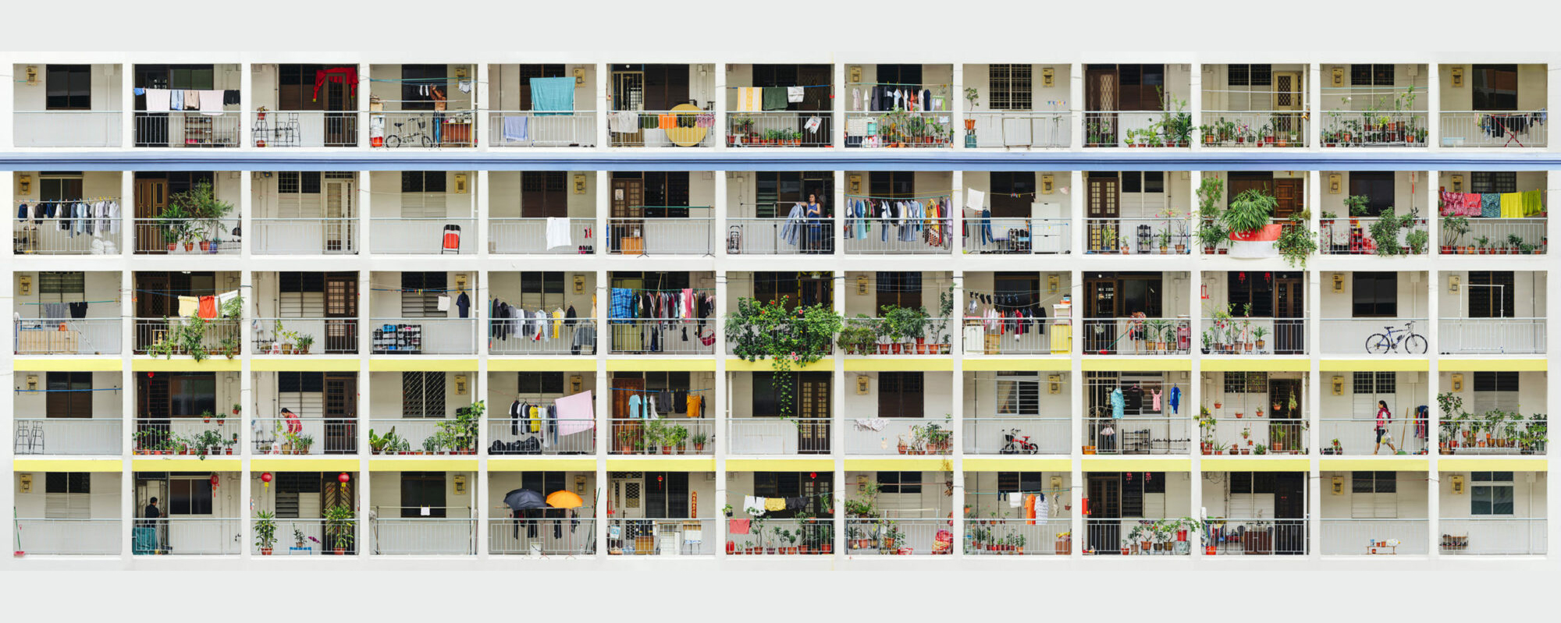
A Model of HDB Resale Prices
Key Features & Insights

Slide 2

Presentation Outline
█ 1. Overview & Objectives
█ 2. Data
█ 3. Empirical Approach
█ 4. Results: Inference
█ 5. Results: Prediction
█ 6. Discussion / Suggestions for Further Research
█ 7. Appendix
█ 8. References

Slide 3
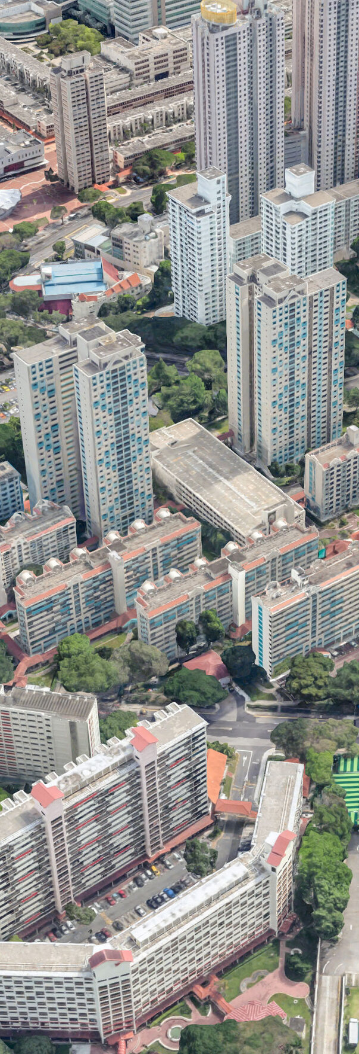
1. Overview & Objectives
Context :: The Value of Modelling HDB Resale Prices
An overwhelming majority (78%) of resident households in Singapore live in HDB apartments (i.e., public housing) [1]
There is thus keen interest in identifying features strongly associated with HDB resale prices, as well as being able to predict prices, amongst:
(a) Home owners / buyers:
to assess what an apartment’s fair value might be
to identify apartments that fit their budget/needs
(b) Policy makers
to identify features residents value, to aid with town planning

Slide 4
1. Overview & Objectives
HDB Resale Price Modelling Objectives
(a) Inference
To separably identify features strongly associated with resale prices,
by assessing their statistical and practical significance
(b) Prediction
To predict resale prices with well, with as narrow a deviation from transacted prices as possible

Slide 5
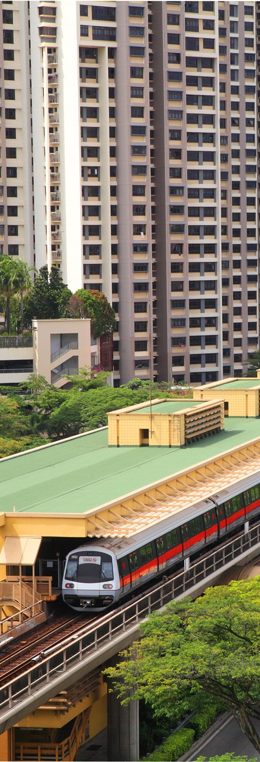
2. Data
HDB Resale Price Dataset
Resale price data over a significant time span, with a large no. of observations [2]
~ 9 years (2012 – ‘21)
~ 150,000 recorded transactions
Incorporating data on a wide range of features (>70), covering the following broad feature categories:
Apartment’s
Physical characteristics (e.g., floor area, floor level)
Remaining lease period
Housing block characteristics (e.g., flat type composition)
Surrounding
Transport infrastructure (e.g., MRT stations)
Amenities (e.g., malls, hawker centres)
Schools

Slide 6
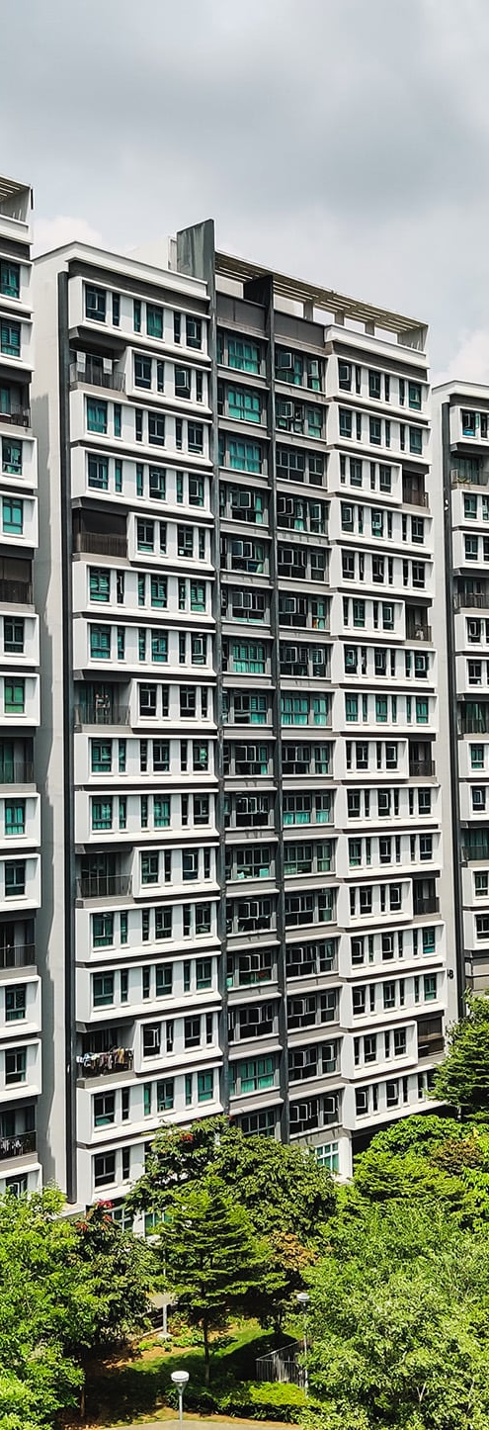
3. Empirical Approach
(-) Dataset Train-Test Splitting
Dataset split 80:20 into ‘training’ and ‘testing’ datasets (*)
(*) The source data package includes ‘training’ and ‘testing’ datasets for which resale price data is only available in the former.
We thus utilise the ‘training’ dataset for analysis, and perform ‘train-test’ splitting on this dataset.
(a) Inference :: To Separably Identify Features Strongly Associated with Resale Prices
Unregularised Multivariate OLS regression modelling using ‘training’ data (*)
(*) Appendix A: Utilising Unregularised (Instead of Regularised) Regression Modelling for Inference
Hypothesis-focused approach to feature selection and engineering, as interpretation of regression coefficients is of primary interest for this analysis
Contextual knowledge (e.g., news reports, interview with a practicing property agent), and exploratory data analysis utilised to derive features
Feature set examined for multicollinearity as it causes unstable coefficient estimates, and understatement of statistical significance:
Feature set’s Variance Inflation Factors (VIFs) examined
VIFs <10 : indicating absence of multicollinearity [3]

Slide 7
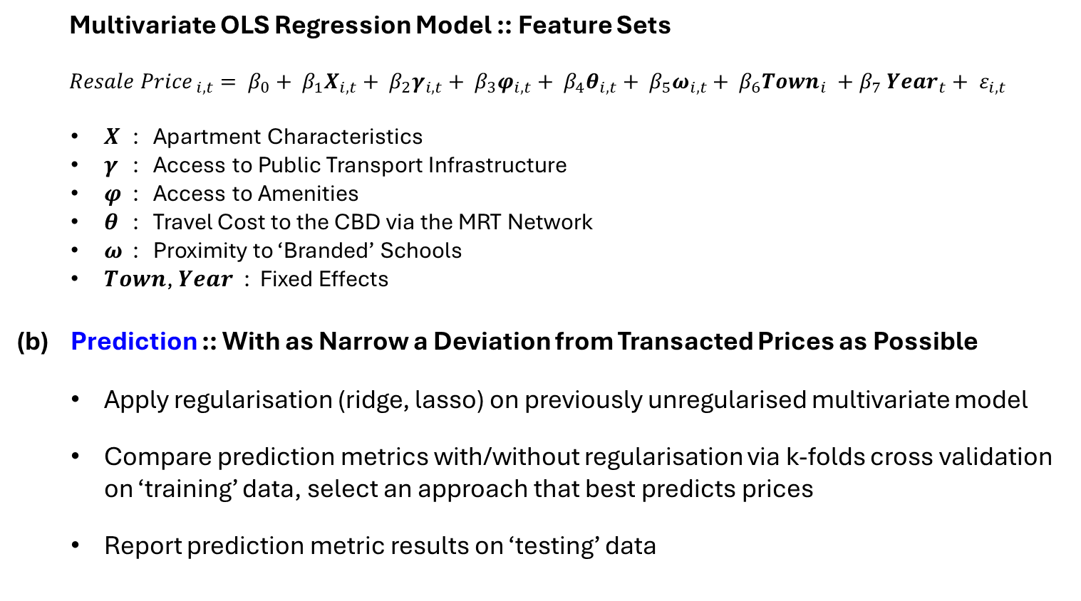
3. Empirical Approach
Multivariate OLS Regression Model :: Feature Sets
$${Resale Price}_{ i,t}= β_{0}+ β_{1}X_{i,t}+ β_{2}γ_{i,t}+ β_{3}φ_{i,t}+ β_{4}θ_{i,t}+ β_{5}ω_{i,t}+ β_{6}{Town}_{i} {+ β}_{7}{Year}_{t}+ ε_{i,t}$$
𝑿 : Apartment Characteristics
𝜸 : Access to Public Transport Infrastructure
𝝋 : Access to Amenities
𝜽 : Travel Cost to the CBD via the MRT Network
𝝎 : Proximity to ‘Branded’ Schools
$Town$, $Year$ : Fixed Effects
(b) Prediction :: With as Narrow a Deviation from Transacted Prices as Possible
Apply regularisation (ridge, lasso) on previously unregularised multivariate model
Compare prediction metrics with/without regularisation via k-folds cross validation on ‘training’ data, select an approach that best predicts prices
Report prediction metric results on ‘testing’ data

Slide 8
3. Empirical Approach
Multivariate OLS Regression Model
$${Resale Price}_{ i,t}= β_{0}+ β_{1}X_{i,t}+ β_{2}γ_{i,t}+ β_{3}φ_{i,t}+ β_{4}θ_{i,t}+ β_{5}ω_{i,t}+ β_{6}{Town}_{i} {+ β}_{7}{Year}_{t}+ ε_{i,t}$$
𝑿 : Apartment Characteristics | Remarks
Floor Area (Sqm) , Floor Area (Sqm) ² | -
Floor Level , Floor Level ² | -
Flat Type: If DBSS | To reflect these flat types’ private property-like features
Flat Type: If Terrace | Reference category: flat type is neither of these types
Flat Type: If Maisonette / Loft
Flat Type: If Duxton (S1/S2)
Remaining Lease Years , Remaining Lease Years ² | -
Within Block: If Rental Units Present | To capture possible neighbour preference

Slide 9
3. Empirical Approach
Multivariate OLS Regression Model
$${Resale Price}_{ i,t}= β_{0}+ β_{1}X_{i,t}+ β_{2}γ_{i,t}+ β_{3}φ_{i,t}+ β_{4}θ_{i,t}+ β_{5}ω_{i,t}+ β_{6}{Town}_{i} {+ β}_{7}{Year}_{t}+ ε_{i,t}$$
𝜸 : Access to Public Transport Infrastructure | Remarks
Nearest MRT Station (If: Within 500m) | -
Nearest MRT Station (If: >500 to 1000m)
Nearest MRT Station: Is a Bus & MRT Interchange | Reference category:
Nearest MRT Station: Is a MRT Interchange (Only) | Nearest MRT station: neither a bus nor MRT interchange
Nearest MRT Station: Is a Bus Interchange (Only)
Nearest Bus Stop (If: Within 150m) | -

Slide 10
3. Empirical Approach
Multivariate OLS Regression Model
$${Resale Price}_{ i,t}= β_{0}+ β_{1}X_{i,t}+ β_{2}γ_{i,t}+ β_{3}φ_{i,t}+ β_{4}θ_{i,t}+ β_{5}ω_{i,t}+ β_{6}{Town}_{i} {+ β}_{7}{Year}_{t}+ ε_{i,t}$$
𝝋 : Access to Amenities | Remarks
Nearest Mall (If: Within 500m) | -
Nearest Mall (If: >500 to 1000m)
Nearest Hawker Centre (If: Within 500m) | -
Nearest Hawker Centre (If: >500 to 1000m)
Nearest Hawker Centre (If: Large) | Large: >100* Food & Market Stalls * median no. of stalls (amongst all resale price observations)

Slide 11
3. Empirical Approach
Multivariate OLS Regression Model
$${Resale Price}_{ i,t}= β_{0}+ β_{1}X_{i,t}+ β_{2}γ_{i,t}+ β_{3}φ_{i,t}+ β_{4}θ_{i,t}+ β_{5}ω_{i,t}+ β_{6}{Town}_{i} {+ β}_{7}{Year}_{t}+ ε_{i,t}$$
𝜽 : Travel Cost to the CBD via the MRT Network
Travel Cost , Travel Cost ²
Remarks / Hypotheses
HDB residents tend to travel by the MRT, and there is a penalty (premium) to being further (closer) to the Central Business District (CBD) in terms of travel cost along the MRT network
Penalty may be due to the added inconvenience of accessing job opportunities in the CBD, and lower potential rental income yield for home owners
Expect the penalty to diminish at tail ends of the network due to presence of regional economic centres (e.g., Jurong Industrial Zone, Loyang Aviation Cluster / Changi Business Park) [4]

Slide 12
3. Empirical Approach
Multivariate OLS Regression Model
$${Resale Price}_{ i,t}= β_{0}+ β_{1}X_{i,t}+ β_{2}γ_{i,t}+ β_{3}φ_{i,t}+ β_{4}θ_{i,t}+ β_{5}ω_{i,t}+ β_{6}{Town}_{i} {+ β}_{7}{Year}_{t}+ ε_{i,t}$$
𝜽 : Travel Cost to the CBD via the MRT Network
Travel Cost , Travel Cost ²
Remarks / Feature Construction Approach
Resale price data spans 2012 – ’21, and the network has evolved during the period (e.g., introduction of the Downtown Line (2017), Thompson-East Cost Line (2020)) [5,6]
Expect home buyers to consider evolution of the MRT network when making purchase decisions (alongside other future-oriented area development plans), and thus consider the MRT network as at 2024
Travel Cost = Minimum No. of MRT Stations to a list of CBD Stations * (*transfers across MRT lines modelled as travelling through another MRT station – to reflect cost of making transfers)

Slide 13
3. Empirical Approach
Multivariate OLS Regression Model
$${Resale Price}_{ i,t}= β_{0}+ β_{1}X_{i,t}+ β_{2}γ_{i,t}+ β_{3}φ_{i,t}+ β_{4}θ_{i,t}+ β_{5}ω_{i,t}+ β_{6}{Town}_{i} {+ β}_{7}{Year}_{t}+ ε_{i,t}$$
𝝎 : Proximity to ‘Branded’ Schools
No. of ‘Branded’ Primary Schools (Within 1 km) | No. of ‘Branded’ Secondary Schools (Within 1 km)
No. of ‘Branded’ Primary Schools (>1 to 2 km) | No. of ‘Branded’ Secondary Schools (>1 to 2 km)
Remarks / Hypotheses
Priority for admission into a given primary school is based on proximity, with children living (a) within 1km of the school being granted higher priority than those living (b) between 1km - 2km, and (c) beyond 2km [7]
Given competition for places in ‘branded’ primary schools, parents may be willing to pay a premium to purchase homes near these schools, to increase chances of their children being granted admission [8]
Although proximity-based priority admission to secondary schools is not practiced – it is possible but less certain if being located close by these schools carries a resale price premium

Slide 14
3. Empirical Approach
Multivariate OLS Regression Model
$${Resale Price}_{ i,t}= β_{0}+ β_{1}X_{i,t}+ β_{2}γ_{i,t}+ β_{3}φ_{i,t}+ β_{4}θ_{i,t}+ β_{5}ω_{i,t}+ β_{6}{Town}_{i} {+ β}_{7}{Year}_{t}+ ε_{i,t}$$
𝝎 : Proximity to ‘Branded’ Schools
No. of ‘Branded’ Primary Schools (Within 1 km) | No. of ‘Branded’ Secondary Schools (Within 1 km)
No. of ‘Branded’ Primary Schools (>1 to 2 km) | No. of ‘Branded’ Secondary Schools (>1 to 2 km)
Remarks / Feature Construction Approach
Rely on a school classification approach used in a research paper by the Singapore Children’s Society to identify ‘branded’ primary and secondary schools
‘Branded’ primary schools: offer the Gifted Education Programme, are affiliated to Integrated Programme Secondary Schools, or are government-aided
‘Branded’ secondary schools: offer the Integrated Programme, or are autonomous schools [9]

Slide 15
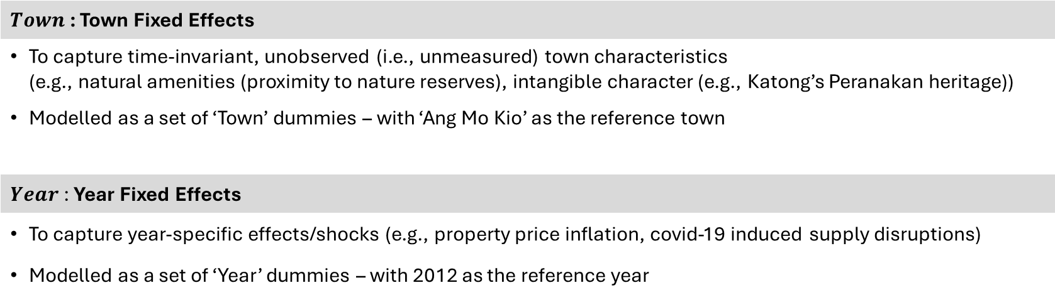
3. Empirical Approach
Multivariate OLS Regression Model
$${Resale Price}_{ i,t}= β_{0}+ β_{1}X_{i,t}+ β_{2}γ_{i,t}+ β_{3}φ_{i,t}+ β_{4}θ_{i,t}+ β_{5}ω_{i,t}+ β_{6}{Town}_{i} {+ β}_{7}{Year}_{t}+ ε_{i,t}$$
$Town$ : Town Fixed Effects
To capture time-invariant, unobserved (i.e., unmeasured) town characteristics (e.g., natural amenities (proximity to nature reserves), intangible character (e.g., Katong’s Peranakan heritage))
Modelled as a set of ‘Town’ dummies – with ‘Ang Mo Kio’ as the reference town
$Year$ : Year Fixed Effects
To capture year-specific effects/shocks (e.g., property price inflation, covid-19 induced supply disruptions)
Modelled as a set of ‘Year’ dummies – with 2012 as the reference year

Slide 16
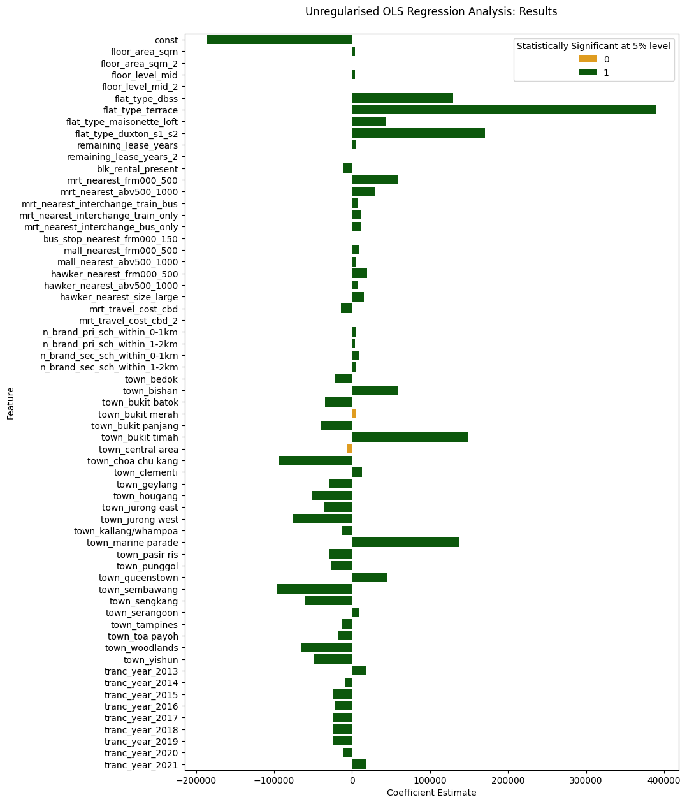
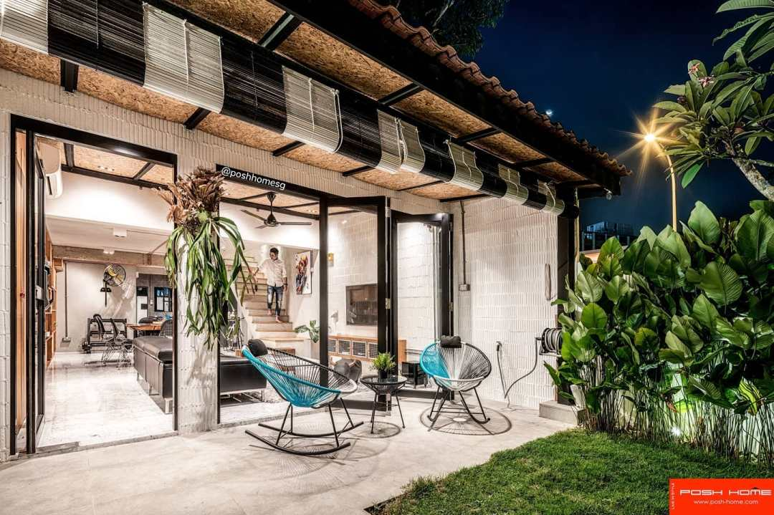
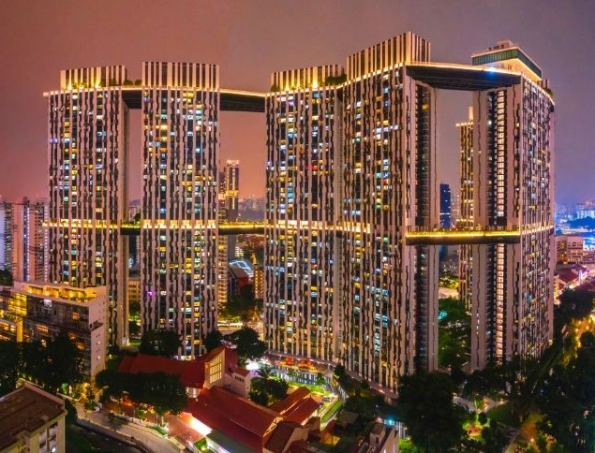
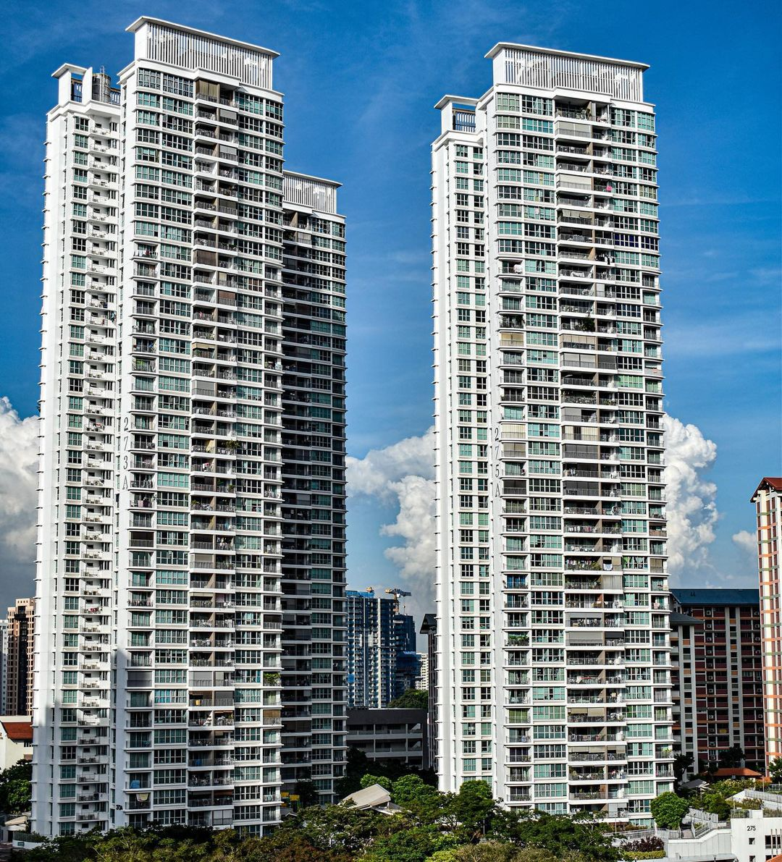
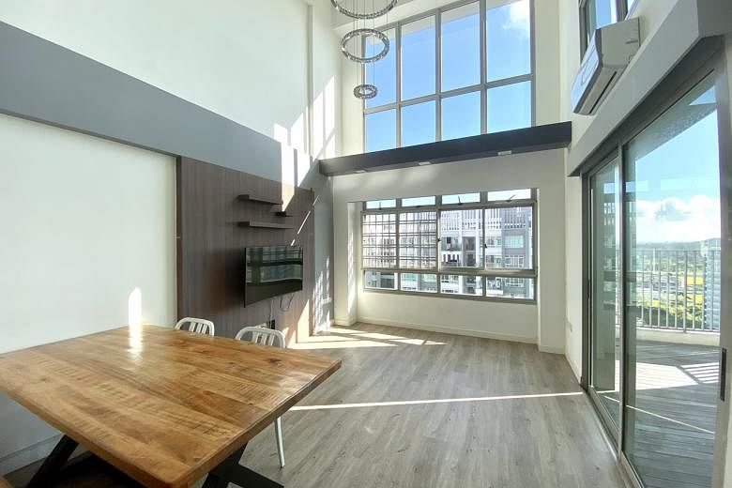
4. Results: Inference
Features Most Strongly Associated with Resale Price
Apartment Characteristics
(1) Exceptional Flat Types
Terrace (+ ~$390,000)
Duxton S1/S2 (+ ~$170,000)
DBSS (+ ~$130,000)
Maisonette/Loft (+ ~$44,000)
Flat types embodying observable private property-like features have the highest coefficient estimates
(L) HDB Terrace units akin to a landed-property
(M-L) Duxton S1/S2 units, iconic public housing development with sky terraces
(M-R) DBSS units by private developers, akin to condominiums externally and with premium interiors [10]
(R) Maisonette /Loft units with high-ceilings, akin to a ‘double-story landed property in the sky’

Slide 17
4. Results: Inference
Features Most Strongly Associated with Resale Price
Apartment Characteristics
(1) Exceptional Flat Types
Terrace (+ ~$390,000)
Duxton S1/S2 (+ ~$170,000)
DBSS (+ ~$130,000)
Maisonette/Loft (+ ~$44,000)
On average and holding other features constant (e.g., floor area), home buyers are estimated to value apartments of these flat types over others (e.g., ‘new generation’, ‘improved’, that do not possess observable private property-like features) at the amounts above
However, these estimates may also embody the effects of unobserved features associated with these flat types
(e.g., more luxurious home renovation works, if home owners of these flat types tend to invest more on renovating their homes)

Slide 18
4. Results: Inference
Features Most Strongly Associated with Resale Price
Apartment Characteristics
(2) Flat’s Floor Area
Floor Area (sqm) (+ ~$3,500/sqm)
Larger flats command a price premium of ~ $3,500/sqm (*)
(on average, holding other features constant)
Considering that the average size of a flat in our sample is ~100 sqm:
10% (10 sqm) increase in floor area (from the mean) is thus associated with a $35,000 increase in resale price
(*) The ‘floor area – resale’ price relationship is almost linear, as the coefficient on ‘Floor Area (Sqm)²’ is practically negligible (at value = 3)
+ ~ $35k
100 sqm
110 sqm

Slide 19
4. Results: Inference
Features Most Strongly Associated with Resale Price
Apartment Characteristics
(3) Flat’s Remaining Lease Years
Remaining Lease Years (+ ~$4,300/year)
Considering the matter of lease decay, an additional remaining lease year is associated with a $4,300 increase in resale price (*)
(on average, and holding other features constant)
A 10 year increase in remaining lease is thus associated with a $43,000 increase in resale price
(*) ‘Remaining Lease Years – Resale Price’ relationship: we do not find support for a non-linear relationship between remaining lease years and resale price - but this may be an artifact of our sample not having observations that are closer to lease termination (average remaining lease = 75, min = 45 years) – where we might expect rapidly diminishing resale prices closer to termination

Slide 20

4. Results: Inference
Features Most Strongly Associated with Resale Price
Public Transport Connectivity
(1) Proximity to an MRT Station
Nearest MRT Station (If: Within 500m) (+ ~$59,000)
Nearest MRT Station (If: >500 to 1000m) (+ ~$30,000)
Being closer to an MRT station commands a price premium:
Flats within 0.5km (0.5 to 1km) to the nearest MRT station are on average $59,000 ($30,000) more expensive than flats located 1km away, holding other features constant
(2) Nearest MRT Station Being a Public Transport Hub
Price premiums are also associated with the nearest MRT station being a public transport interchange:
Resale prices being $8,000 to $12,000 higher when the nearest MRT station is a bus and/or MRT interchange, compared to it being a MRT station alone

Slide 21
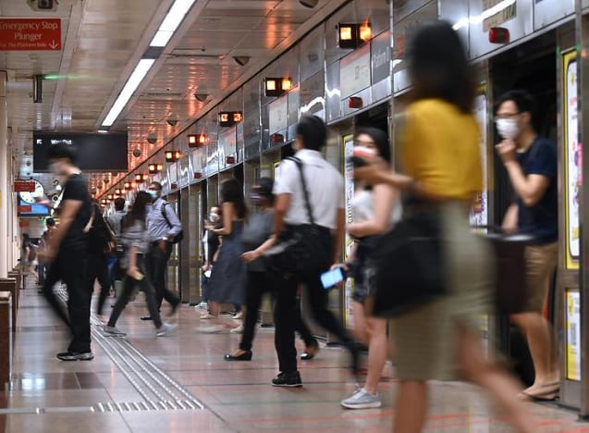
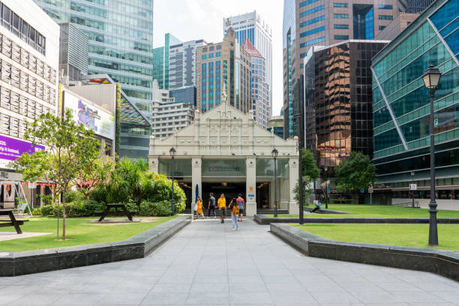

4. Results: Inference
Features Most Strongly Associated with Resale Price
Travel Cost to the CBD via the MRT Network
Travel Cost (- ~$14,000 / cost unit)
A one unit increase in travel cost to the CBD via the MRT network
is akin to travelling an additional MRT stop to reach the CBD.
Considering that the average travel cost in our sample is 10, this implies a penalty of ~$140,000 when the travel cost is at such
– on average, and holding other features constant
(*) While there is evidence of the travel cost penalty diminishing at regions further away from the CBD (perhaps due to closer proximity to regional economic clusters) - the rate at which the penalty diminishes is low, as the coefficient estimate on the travel cost-squared term is ~$160

Slide 22
4. Results: Inference
Features Most Strongly Associated with Resale Price
Town-level Fixed Effects
Relative to prices of resale flats sold in Ang Mo Kio (the reference town), and after controlling for observable features in our model, resale flats sold in the following towns were priced substantially higher/lower:
Bukit Timah (+ ~$149,000)
Marine Parade (+ ~$137,000)
Bishan (+ ~$59,000)
Sembawang (- ~$96,000)
Chua Chu Kang (- ~$93,000)
Jurong West (- ~$76,000)
These differences are practically substantial - considering that the mean resale price in our data is ~$450,000

Slide 23
5. Results: Prediction
Recap: Background & Approach
As the objective of this analysis is to build a model that predicts resale prices well, ridge and lasso regularisation has been applied on the previously unregularised multivariate model – to assess if regularisation improves its predictive ability and generalisability
Prediction Metrics
 |  | Unregularised | Ridge | Lasso
Training | R-squared | 0.89 | 0.89 | 0.89
 | MAE | $36,650 | $36,650 | $36,650
 | MAPE | 0.086 | 0.086 | 0.086
k-Folds | R-squared | 0.89 | 0.89 | 0.89
Cross-Val | MAE | $36,680 | $36,680 | $36,680
 | MAPE | 0.086 | 0.086 | 0.086
Testing | R-squared | 0.89 | 0.89 | 0.89
 | MAE | $36,360 | $36,360 | $36,360
 | MAPE | 0.086 | 0.086 | 0.086
No discernible difference in predictive performance across 'unregularised', 'ridge' and 'lasso' approaches (*)
(*) Expected, as search for optimal regularisation alphas reveals that optimal values are close to zero (ridge: 0.01, lasso: 0.16)
No evidence of trained model exhibiting overfitting, as Mean Absolute Error (MAE) on ‘Testing’ data ($36,360) is in fact slightly lower than that from the ‘Training’ data ($36,650)
With reference to the ‘Testing’ results, our model:
Explains ~ 89% of the variation in resale price (R-squared)
Has a Mean Absolute Error (MAE) of ~$36,000
Has a Mean Absolute Percentage Error of ~8.6%

Slide 24
6. Discussion / Suggestions for Further Research
(a) Summary of Results & Potential Use Cases
Features Most Strongly Associated with Resale Price
Expectedly and from a practical standpoint, features found to be most strongly associated with resale price are:
Apartment Characteristics Exceptional Flat Types, Flat’s Floor Area, Flat’s Remaining Lease Years
Public Transport Connectivity Proximity to an MRT Station, Nearest MRT Station Being a Public Transport Hub
Travel Cost to the CBD via the MRT Network
Town-level Unobserved Features
These insights might be utilised in the following ways by different stakeholders, as follows:
Home Buyers | Guide search for a suitable apartment For example, if a home buyer’s budget is constrained, he/she could focus on: (a) towns associated with lower resale prices (e.g., Sembawang, Chua Chu Kang), and (b) apartments further away from the nearest MRT station
Home Owners | Form expectations regarding resale value enhancement / degradation E.g., stemming from announcement of public works (new MRT station construction), remaining lease decay
Policy Makers | Consider studying if regional economic centre development plans should be enhanced As travel cost penalty to the CBD via the MRT network does not diminish significantly at the network’s tail ends, attractiveness of regional economic centres could be studied, with greater economic decentralisation in mind

Slide 25
6. Discussion / Suggestions for Further Research
(a) Summary of Results & Potential Use Cases
Predictive Ability of the Resale Price Model
Has a Mean Absolute Error (MAE) of ~$36,000
Has a Mean Absolute Percentage Error of ~8.6%
The predictive model could be used by:
Home Buyers / Home Owners | To assess what an apartment’s fair value might be However it should be noted that the model is, strictly speaking, valid within the time period analysed (2012-21) Forming estimates at later time periods should ideally be performed by refitting the model with more current data
(b) Suggestions for Further Research
To consider including other features, such as:
Proximity to green spaces (e.g., parks, nature reserves)
Environmental quality (e.g., air quality, ambient noise levels)
Proximity to industrial estates (e.g., by industrial type – heavy / light)
As these could lend further insight on attributes (not) valued by homeowners, and aid with urban planning cost/benefit analyses

Slide 26


Slide 27
Additional Slides
█ 7. Appendix
Appendix A: Utilising Unregularised (Instead of Regularised) Regression Modelling for Inference
Appendix B: Other Features Associated with Resale Price
█ 8. References

Slide 28
7. Appendix A : Utilising Unregularised (Instead of Regularised) Regression Modelling for Inference
Regularisation (ridge/lasso) has not been utilised for this purpose, as the approach produces biased coefficient estimates – which stem from:
(a) Regularisation inherently biasing coefficient estimates towards zero
i.e., accepting greater model bias in exchange for lower variance - with the view towards increasing a model's generalisability in a prediction context [11]
(b) Risk of introducing omitted variable bias (OVB) when lasso regularisation is applied
While the approach can aid with feature selection (as it allows coefficient shrinkage to reach zero) - features that are subsequently dropped (i.e., features with coefficient estimates = zero) may be associated with the remaining feature(s) and outcome, resulting in the remaining feature(s)' coefficients being affected by OVB
While OVB is not a concern in the context of prediction, it is the context of inference - as OVB can lead to over/underestimation of a coefficient's magnitude [12]

Slide 29
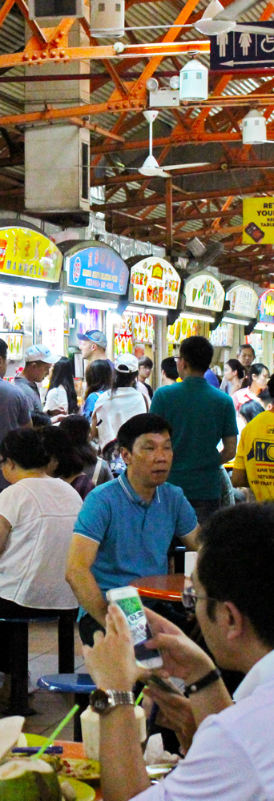
7. Appendix B : Other Features Associated with Resale Price (1)
The following features were found to be associated with resale price, albeit not as strongly as features discussed earlier. The results herein may nonetheless be of interest:
(1) Proximity to Malls / Hawker Centres
Being located within (as opposed to being beyond) 1km of a mall (hawker centre) commands a price premium between $4,500 to $9,000 ($7,100 to $19,000), depending on proximity and holding other features constant
Resale prices are on average $15,000 higher if the nearest hawker centre is large
(i.e., has more than 100 food and market stalls), as opposed to being small
(2) Proximity to ‘Branded’ Schools
The average number of ‘branded’ primary (secondary) schools within 1km of a resale flat stands at less than 1 (0.5, 0.4)
An additional ‘branded’ primary (secondary) school within this radius is estimated to command a price premium of $5,300 ($9,600), holding other features constant
A potential reason why the price premium on ‘branded’ schools is not higher could be due to 'branded’ school effects being more pronounced among private-property transactions instead - where willingness-to-pay is likely higher among this group of higher-income home buyers

Slide 30
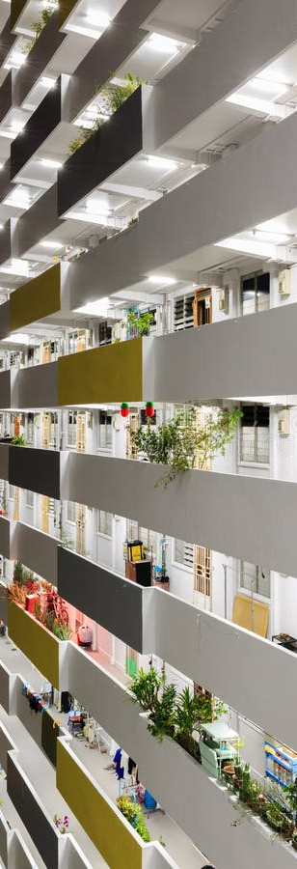
7. Appendix B : Other Features Associated with Resale Price (2)
The following features were found to be associated with resale price, albeit not as strongly as features discussed earlier. The results herein may nonetheless be of interest:
(3) Within Block Neighbours
The presence of rental units within a block is associated with a price penalty of $11,000 on average, and holding other features constant
This is consistent with reports of residents preferring to live a distance away from rental unit (i.e., low-income) residents [13]
From a policy perspective, the presence of the penalty is concerning as this might be due to:
Undue stigmatisation
Social issues associated with 'rental' unit residents that have spillover effects on neighbours
Understanding the underlying cause(s) of the penalty could thus aid with developing interventions to address them

Slide 31
8. References
[1] Singapore Department of Statistics (2023). Resident Households by Type of Dwelling.
https://www.singstat.gov.sg/find-data/search-by-theme/households/households/latest-data
[2] Wee S. C. & Soon P. C. (2022). DSI-SG Project 2 Regression Challenge (HDB Price). Kaggle.
https://www.kaggle.com/competitions/dsi-sg-project-2-regression-challenge-hdb-price/data
[3] University of California Los Angeles (UCLA) (2021). Regression with STATA Chapter 2 - Regression Diagnostics. https://stats.oarc.ucla.edu/stata/webbooks/reg/chapter2/stata-webbooksregressionwith-statachapter-2-regression-diagnostics
[4] Business Times (2019). Regional Hubs – An Alternative to City Living.
https://www.businesstimes.com.sg/property/regional-hubs-alternative-city-living
[5] Land Transport Authority (2024). Downtown Line.
https://www.lta.gov.sg/content/ltagov/en/getting_around/public_transport/rail_network/downtown_line.html
[6] Land Transport Authority (2024). Thompson-East Coast Line.
https://www.lta.gov.sg/content/ltagov/en/upcoming_projects/rail_expansion/thomson_east_coast_line.html
[7] Ministry of Education (2024). How Distance Affects Priority Admission.
https://www.moe.gov.sg/primary/p1-registration/distance
[8] Channel News Asia (2023). Prices of Tengah Homes Near ACS (Primary) could Rise 10% to 15%: Property Analysts
https://www.channelnewsasia.com/singapore/acs-primary-tengah-property-prices-school-relocate-3265786
[9] Ong X. L & Cheung H. S. (2016). Schools & The Class Divide: An Examination of Children’s Self-Concept & Aspirations in Singapore. Singapore Children’s Society.
https://www.childrensociety.org.sg/wp-content/uploads/2022/07/Schools-and-Class-Divide_Research-Monograph-11_FINAL_24-Aug-2016v3.pdf
[10] Stacked Homes (2021). A Detailed List of 13 DBSS Projects and their Prices Today
https://stackedhomes.com/editorial/a-detailed-list-of-13-dbss-projects-and-their-prices-today

Slide 32
8. References
[11] Clark et al. (2022). What Makes a Satisfying Life - Prediction & Interpretation with Machine-Learning Algorithms. London School of Economics & Political Science - Center for Economic Performance. https://eprints.lse.ac.uk/117887/1/dp1853.pdf
[12] Wuthrich & Zhu (2023). Omitted Variable Bias of Lasso-based Inference Methods - A Finite Sample Analysis. Review of Economics & Statistics. https://arxiv.org/pdf/1903.08704.pdf
[13] Today (2023). The Big Read: Can public rental and BTO flats co-exist? Social mixing at special HDB blocks faces stereotypes, misperceptions
https://www.todayonline.com/big-read/big-read-public-rental-bto-hdb-flat-special-blocks-stereotypes-social-mixing-2211446

